Slide 1


Jaime Castillo
Spotipy
Rise and Fall of The Genres.

Slide 2

k
Jaime Castillo
Welcome
The Ages
Welcome
The Length
Explicit
Men and Woman
Rise of the Genres is a brief study of the evolution of music, from 1940 until today, sweeping the decades top hits to discover what were the factors of their success and see the evolution of the music industry as a whole.
Minorities
Genres
Wrapped
Play
Follow
Thanks

Slide 3


Jaime Castillo
Welcome
The Ages
The Length
Welcome
Data
Explicit
Men and Women
Minorities
Genres
Spotipy
Web Scraping
Million Song
Databases
Wrapped
The majority and gross amount of data was obtained via Spotify’s API, Spotipy.
Scraping the web with BeautifulSoup to get and polish some recent chunks of data.
The Million Song Database helped rounding about some genre and production related data.
To obtain insight into other outliers we used other databases like Kaggle.
Thanks

Slide 4


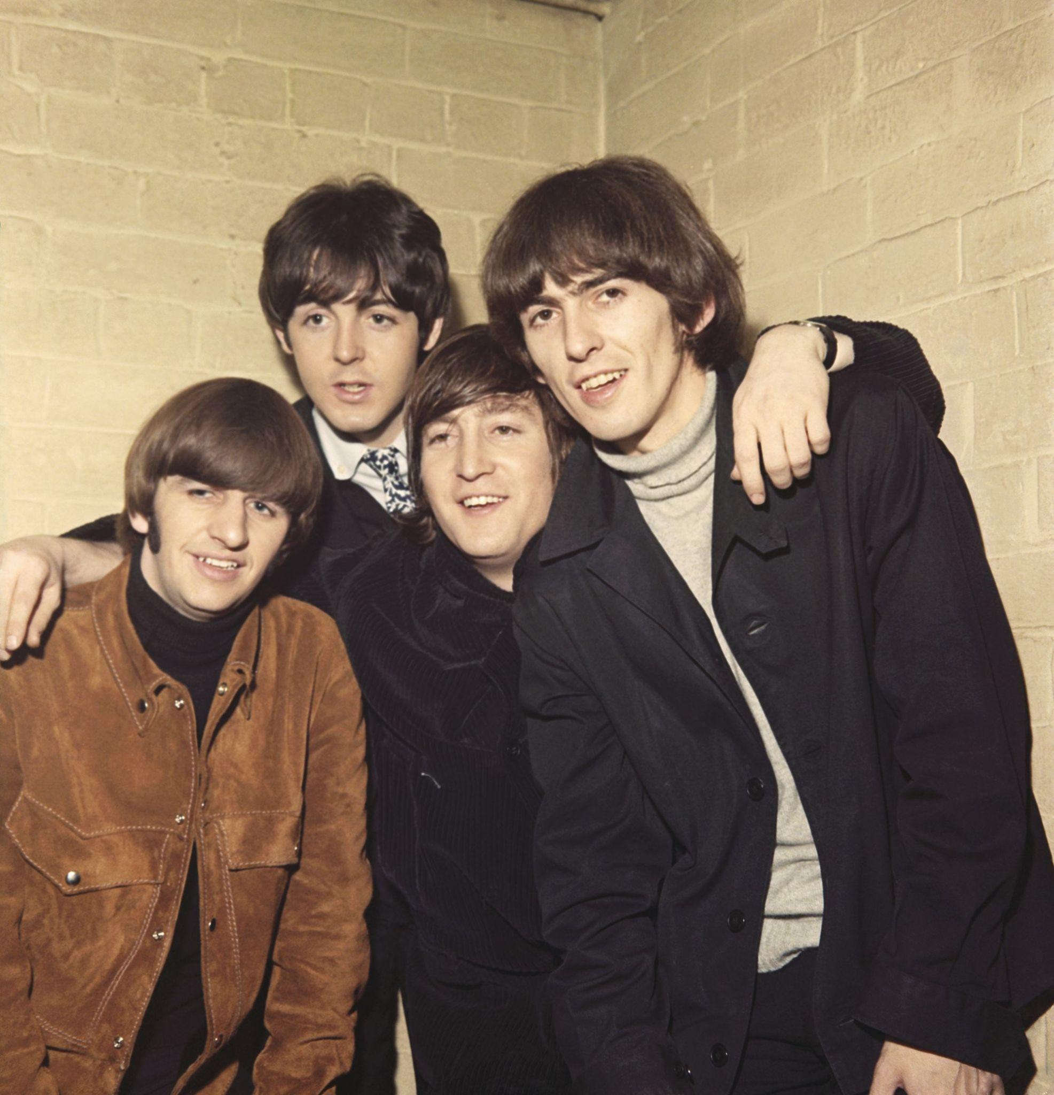
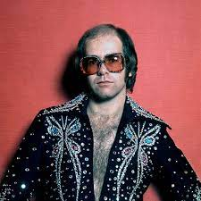
Jaime Castillo
Welcome
The Ages
The Ages
The Length
Explicit
Men and Women
Minorities
Genres
Wrapped
Thanks
1940
1950
1960
1970

Slide 5
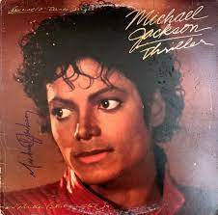



Jaime Castillo
Welcome
The Ages
The Ages
The Length
Explicit
Men and Woman
Minorities
Genres
Wrapped
Thanks
1980
1990
2000
2010

Slide 6
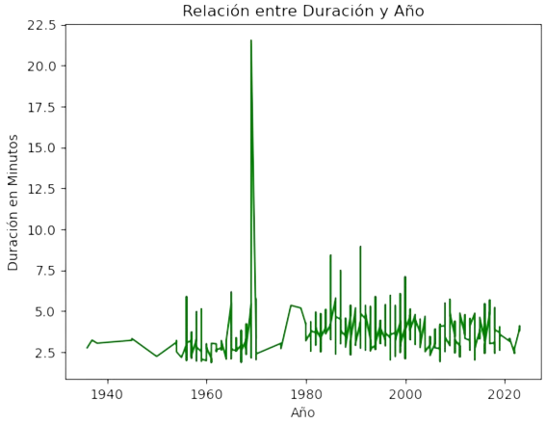
The Length
Jaime Castillo
Welcome
The Ages
The Length
Explicit
Men and Women
Minorities
Genres
Wrapped
Demystifying.
Thanks
Not one decade stands out by song length.
Genre affects length .
Advances in technology had effect only in the beginning of the DataFrame.

Slide 7
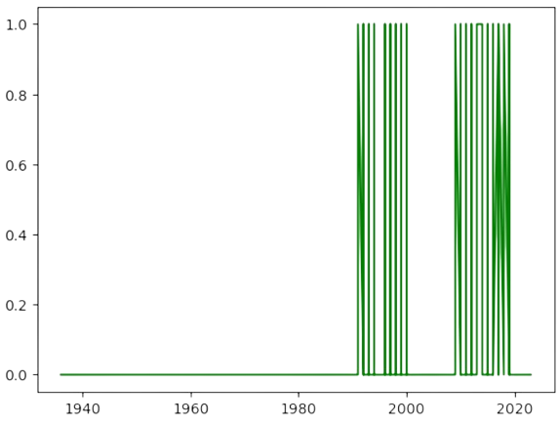
Explicit
Jaime Castillo
Welcome
The Ages
The Length
Explicit
Men and Women
Minorities
Genres
Wrapped
Thanks
How we measure.
Sexual overtones =/= Explicit material
Explicitness is not race related but it is gender related therefore it is race related
Cursing overthrows sexuality

Slide 8
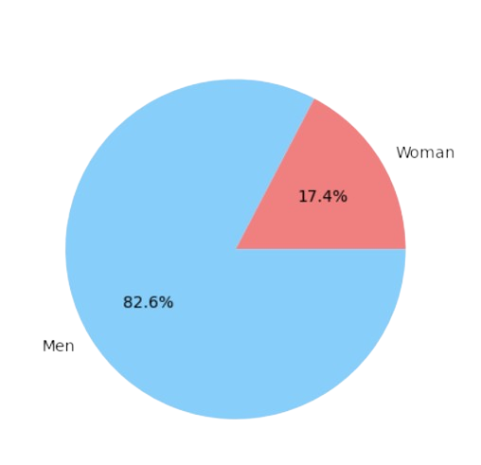
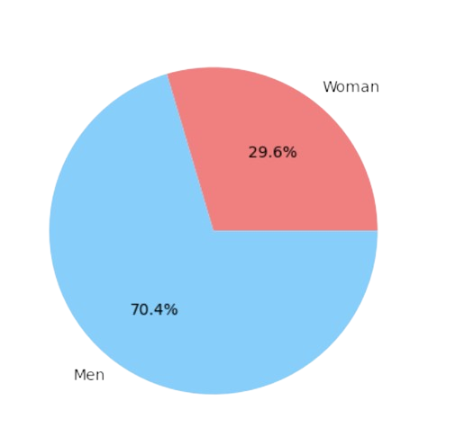
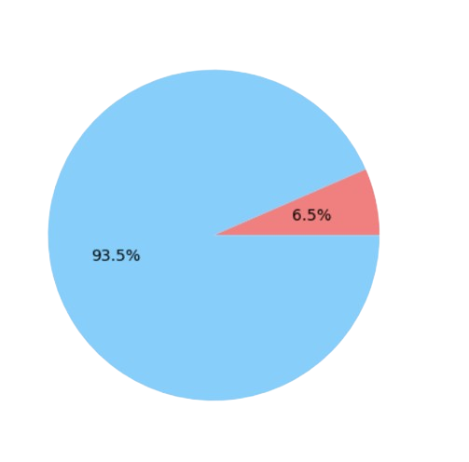
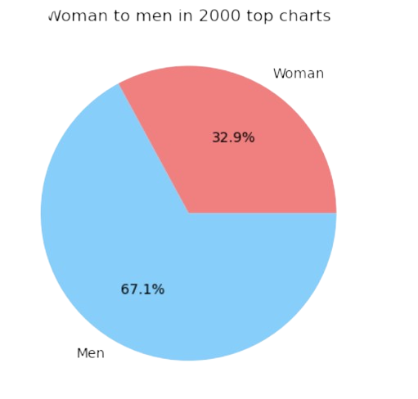
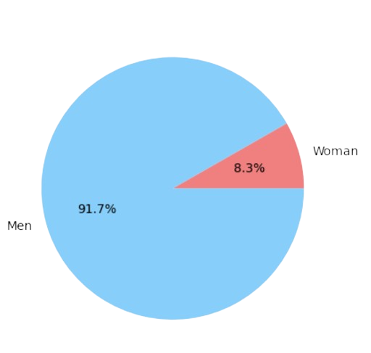
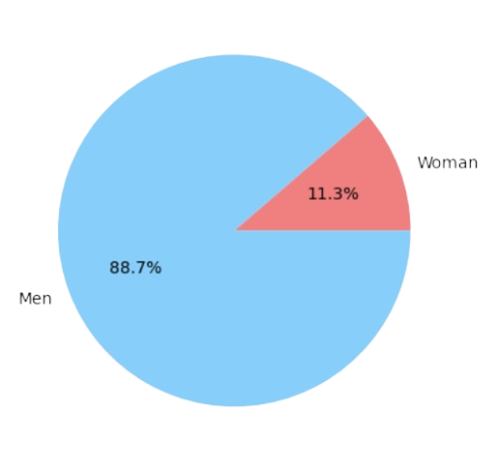
Jaime Castillo
Welcome
The Ages
Men and Women
The Length
Explicit
Men and Women
Minorities
Genres
Wrapped
Thanks
Sing me a song about love
Woman and the age old box.
Rebellion and the racial spectrum.
Themes tie woman to certain music genres.
Popularity and woman stayed the same but production and recognition didnt.

Slide 9
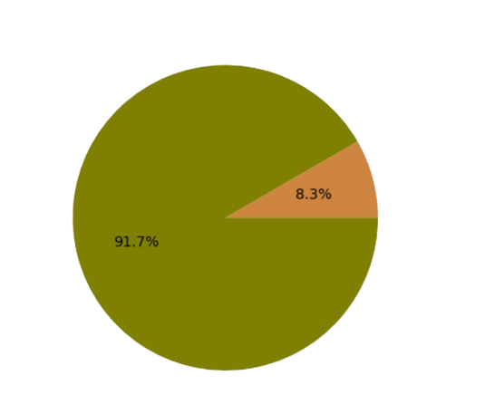
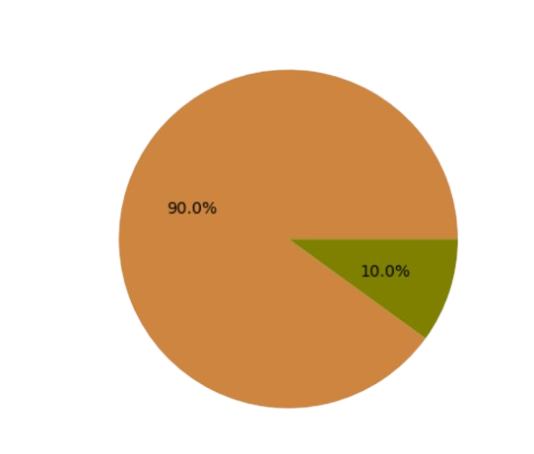
Minorities
Jaime Castillo
Welcome
The Ages
The Length
Explicit
Men and Women
Minorities
Genres
Wrapped
Thanks
The strength of the few
Black women are more prevalent in less popular music genres early on.
Black men and women spearheaded key musical genres in history.
Recent grow of the ‘Latino’ figure started way back when.
Certain genres are almost race exclusive.

Slide 10
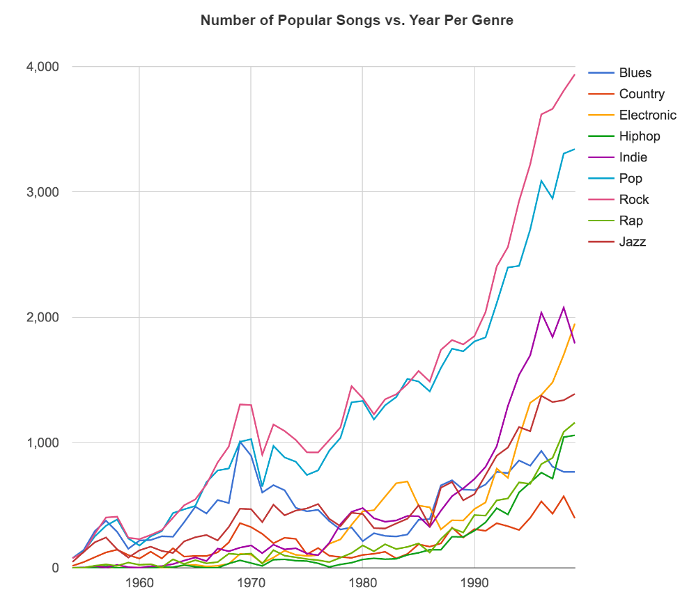
Genres
Jaime Castillo
Welcome
The Ages
The Length
Explicit
Men and Women
Minorities
Genres
Wrapped
Thanks
What means to be truly dead.
Advances in technology explodes musical production.
Trends in popularity only equals revenue not production.
Genres becoming more freeform than static.

Slide 11
Jaime Castillo
Welcome
The Ages
The Length
Explicit
Wrapped through the ages
Men and Women
Minorities
Genres
Wrapped
Thanks

Slide 12

Spotipy
#WRAPPEDTHROUGHTHEAGES

Slide 13

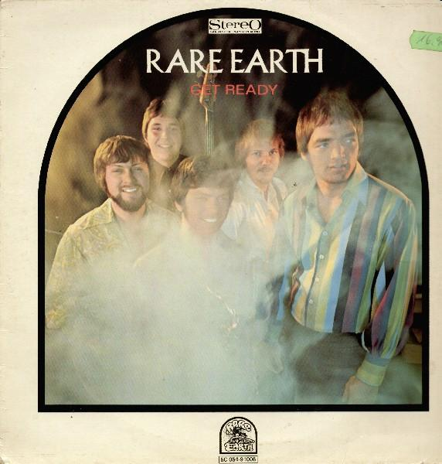

Wrapped
“Más largo que un dia sin pan”
“El tamaño no importa”
“Deja algo para los demás”

Slide 14



Wrapped
“Yo soy español”
“$”
“Girls get it done”

Slide 15



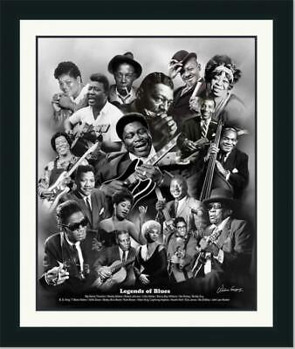
MVP
Black Culture

Slide 16


Thank You
Despacito
Luis Fonsi, Daddy Yankee
0:23
-3:25

